Slide 1
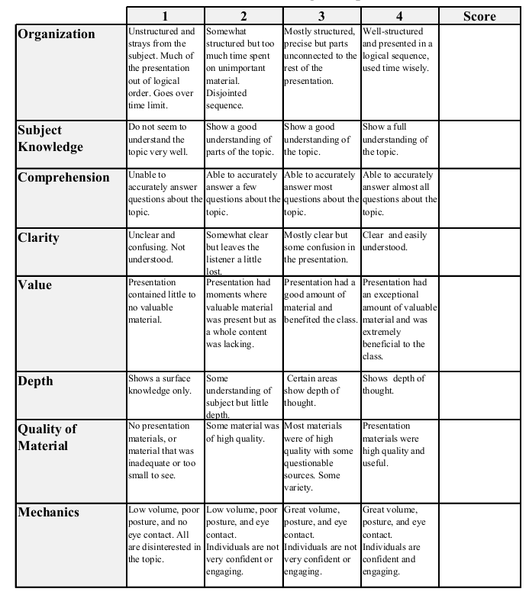
Fall 2014: Econ 339 Final Presentation
Deborah Odagbodo
December 2, 2014
Generic Substitution, Financial Interest, and Imperfect Agency
M. Rischatsh, M. Trottmann and P. Zweifel (2013) Generic Substitution, Financial Interest, and Imperfect Agency, International Journal Health Care Finance Economics 13:1 115-138
Total:_________

Slide 2
What is the article about?
Why does it matter to us?

Slide 3
Background Information
Cheaper brand-name drugs are more often replaced by generics than expensive ones. (Morton-Jones and Pringle, 2009)
Physicians take the cost of the drug to their patients into account before prescribing.
Patients perceive generic drugs as less safe and of lesser quality, causing putative loss.(Griliches and Cockburn, 1994)
Uncertainty about the quality of generic drugs causes physicians to prescribe brand name drugs
Physicians must first convince patients of the bioequivalence of generic drugs to brand-name drugs

Slide 4
Article Summary
Physicians prescribe generic drugs more often brand-name drugs.
Hypothesis 1: Generics offer a higher income contribution to dispensing physicians
Hypothesis 2: Generics are prescribed more often to patients with higher co-insurance rates.
Hypothesis 3: Generics are prescribed more often to patients with lower income.
Hypothesis 4: Patient’s rate of co-insurance is more influential if the physicians do not dispense.
Hypothesis 5: Non-dispensing physicians consider the cost for the insurance company
Hypothesis 6: Physicians working in a managed care setting consider the cost of overall care

Slide 5
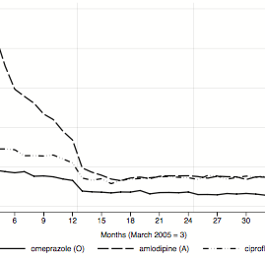
Article Summary Continued
Chemical agents:
- Omeprazole (treats gastric and duodenal abscesses)
- Amlodipine (Calcium channel blocker to treat angina)
- Ciprofloxacin ( treat bacteria infections)
Prescribing physicians anticipated the increase of co-insurance rate for certain brand-name drugs from 10 to 20%

Slide 6
Article Summary Continued
Hypothesis 2: Generics are prescribed more often to patients with higher co-insurance rates.
Hypothesis 3: Generics are prescribed more often to patients with lower income.
Hypothesis 5: Non-dispensing physicians consider the cost for the insurance company
A positive relationship exist between co-payment and generics substitution
Richer patients were prescribed generics less often then lower income patients.
The data is inconclusive, however the high share of generic drugs show that some physicians do act as agent for insurance companies

Slide 7
Questions?
Thank You!

